Slide 1
Functional Test 1 Item Name: Power Core Part number: 801-00001 Doc Revision: 3

Slide 2
History Log
Revision 1 – Initial Release
Revision 2 – Minor Changes
Revision 3 – Add clarification for inspection step

Slide 3
Tools
AC power and ground tester
5V tester (multimeter + modified test cables)

Slide 4
Make sure that the wires and brass are secure by lightly pushing on the components secured by the screws

Slide 5
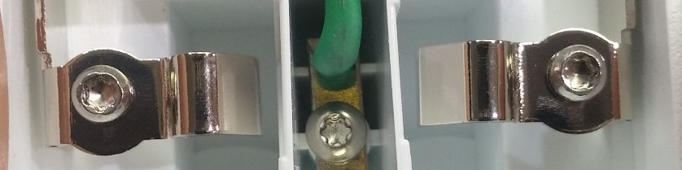
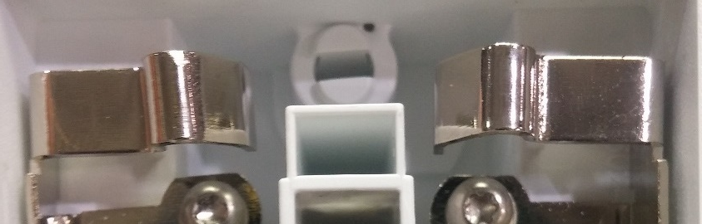
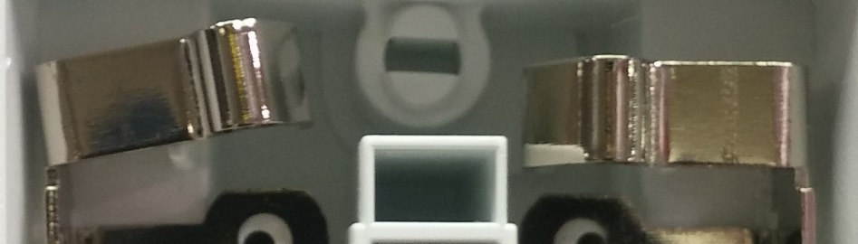
Make sure that the brass looks symmetrical
Good
Good
Bad

Slide 6
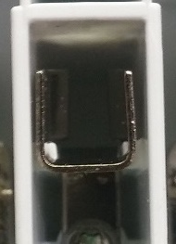
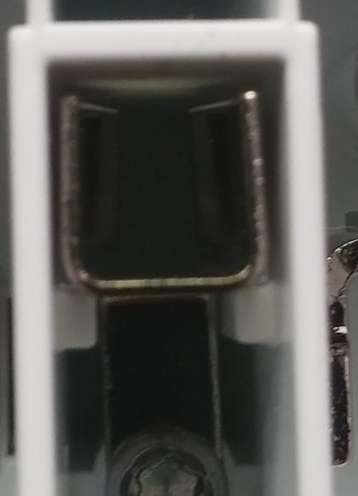
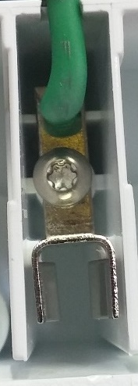
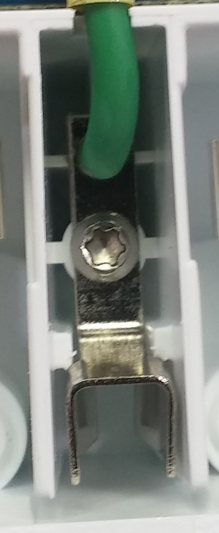
Make sure that the ground is seated on top of the plastic
Good
Good
Bad
Bad

Slide 7
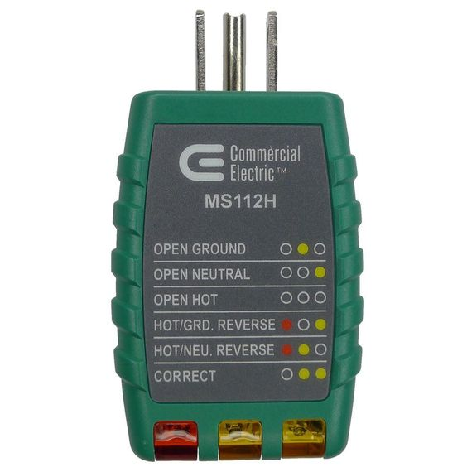
AC power and ground tester
Put the cover on the power core, but don’t weld it yet
Attach a tester into one end of the extension cord and the other end to one of the power core receptacles. Repeat on the other receptacle.
Power up the power core, make sure the results from the testers read “CORRECT”
Make sure the plug retention is good, otherwise, send for rework to adjust brass placement

Slide 8
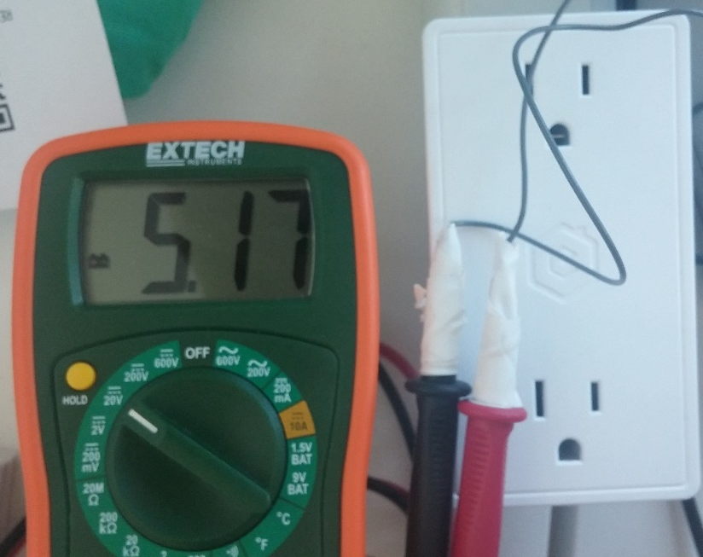
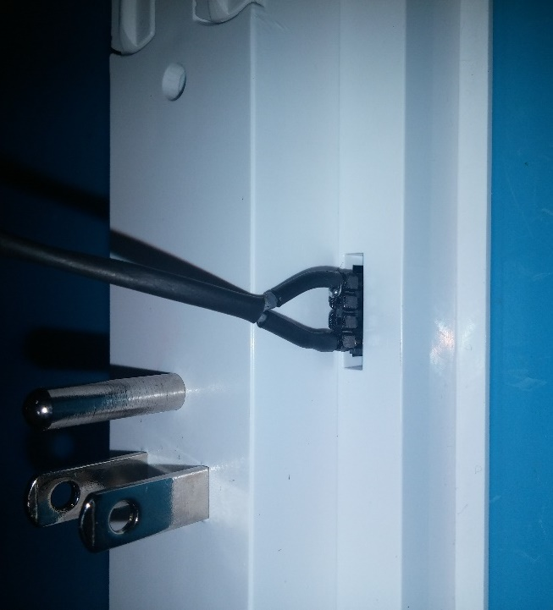
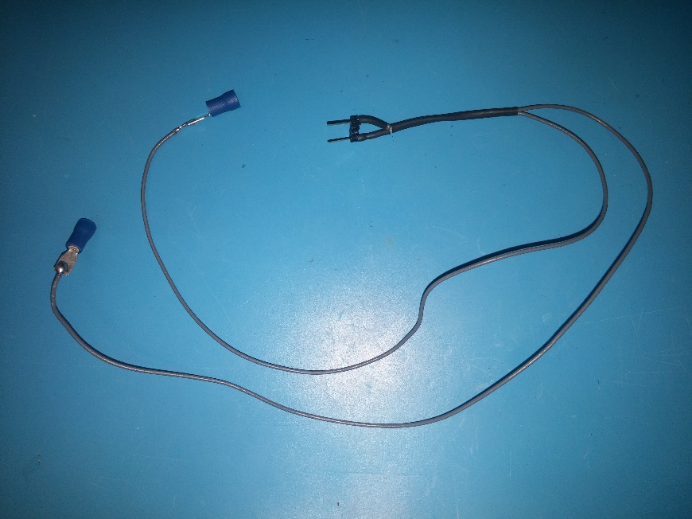
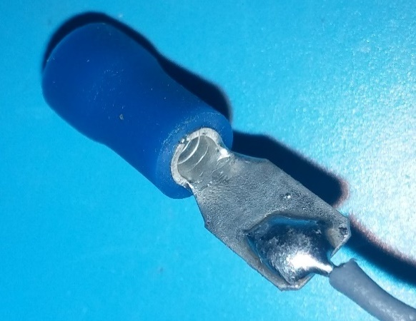
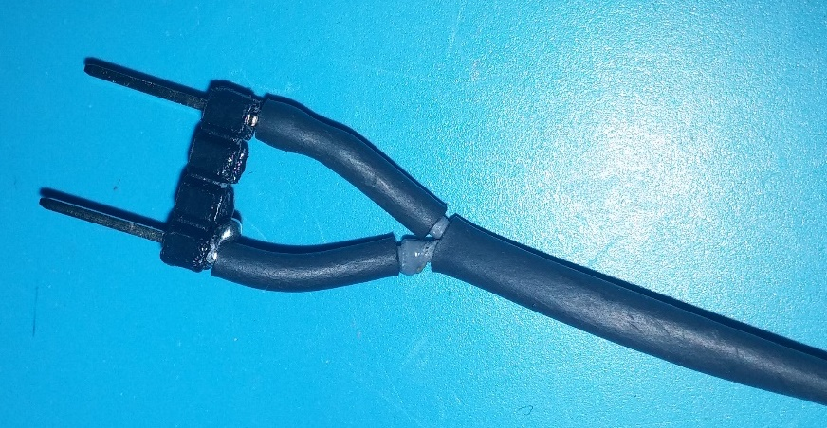
5V tester (Multimeter + modified test cables)
Build test cable
Insert test pins into one of the power core headers
Read ~5V with multimeter

